Slide 1
Dijkstra’s
Algorithm
SC2001 Project 2
SS2 Group 7:
Aloysius Ng, Fabian Tay, Yannaroj Chua

Slide 2
Part (a)
Suppose the input graph G = (V, E) is stored in an adjacency matrix and we use an array for the priority queue. Implement the Dijkstra’s algorithm using this setting and analyze its time complexity with respect to |V| and |E| both theoretically and empirically.

Slide 3
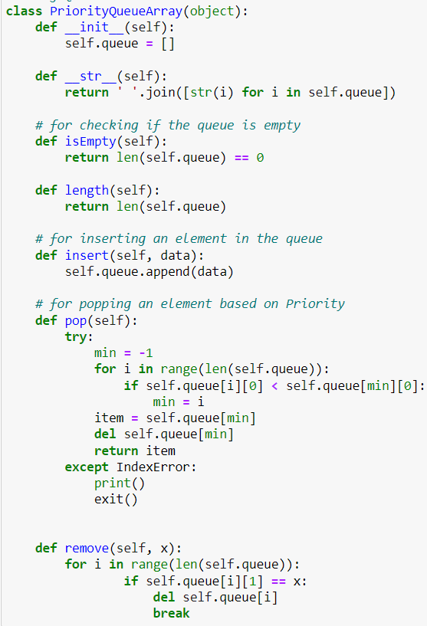
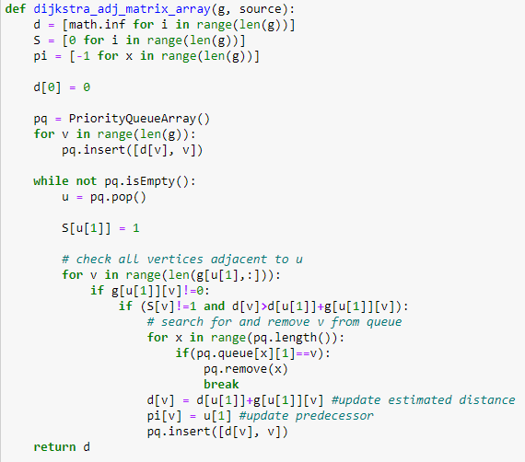
Implementation of Adj. Matrix with Priority Queue

Slide 4
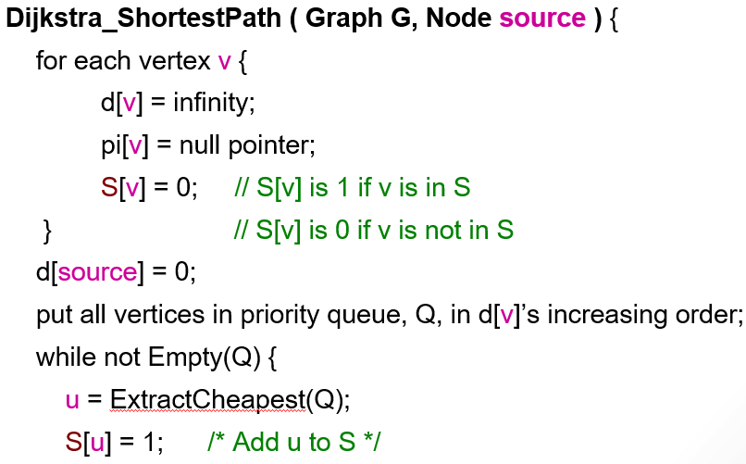
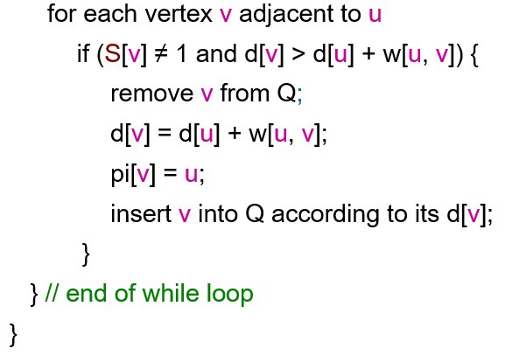
Time Complexity (Theoretical Analysis)
Adjacency Matrix (Array)
O(|V-1)
Initialise: O(|V|)
O(1)
O(1) based on array
O(n) iterations to terminate
O(|V|) to find cheapest in array
O(1)

Slide 5
Implementation of Adj. Matrix with Priority Queue
Let |E| be the number of edges and |V| be the number of Vertices in the graph.
1. We need to find the unvisited vertex with the smallest path. For this part we require O(|V|) time.
2. For each chosen vertex the time required to update its neighbour (if possible) is: O(1)
3. Since, a vertex can have at most (|V-1|) neighbours, the time required to update all of them is: O(1)*O(|V|) = O(|V|)
Time taken for visiting all the vertices = O(|V|)
Time taken for process each vertex = O(|V|)
Therefore, Time required for visiting and processing all the vertices = O(|V|)*O(|V|) = O(|V|²)

Slide 6
Part (b)
Suppose the input graph G = (V, E) is stored in an array of adjacency lists and we use a minimizing heap for the priority queue. Implement the Dijkstra’s algorithm using this setting and analyze its time complexity with respect to |V| and |E| both theoretically and empirically.

Slide 7
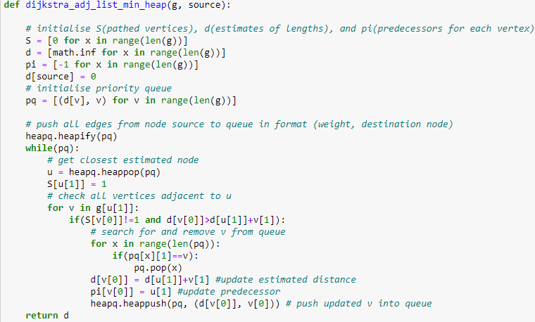
Implementation of Adj. List with Minimising Heap

Slide 8
Time Complexity (Theoretical Analysis)
Adjacency List (Min. Heap)
Initialise: O(|V|)
O(1)
O(log n) based on heappush
O(|V|) iterations to terminate
O(log |V|) to fixHeap after
O(1)

Slide 9
Complexity of Adj. List with Minimising Heap
Let |E| be the number of edges and |V| be the number of Vertices in the graph.
It takes O(|V|) time to construct the initial priority Queue (the min heap).
For the adjacency list, traversing all the neighbours and updating their value takes O(|E|) time.
Time taken for each iteration of loop is O(|V|). As only one vertex is removed from the queue.
Using the min heap, we can extract the node with the minimum distance and update an element in O(log(|V|) time.
Therefore, total time complexity = O(|V|) + O(|E| * log(|V|)) + O(|V| * log(|V|)) =
O((|E|+|V|) * log(|V|))

Slide 10
Part (c)
Compare the two implementations in (a) and (b). Discuss which implementation is better and in what circumstances.

Slide 11
Time Complexity (Theoretical Analysis)
Adjacency Matrix (Array) : O(V²)
Adjacency List (Minimising Heap): O((V+E) logV)
For Sparse graphs:
|E| -> |V|, hence for Adjacency List: O((V+E) logV) -> O((V+V) logV) -> O(V logV), which is better than O(V²).
Adjacency List (Min. Heap) is more efficient than than Adjacency Matrix (Array).
For Dense graphs:
|E| -> |V|², hence for Adjacency List: O((V+E) logV) -> O((V+V²) logV) -> O(V² logV), which is worse than O(V²).
Adjacency Matrix (Array) would be more efficient in this case.

Slide 12
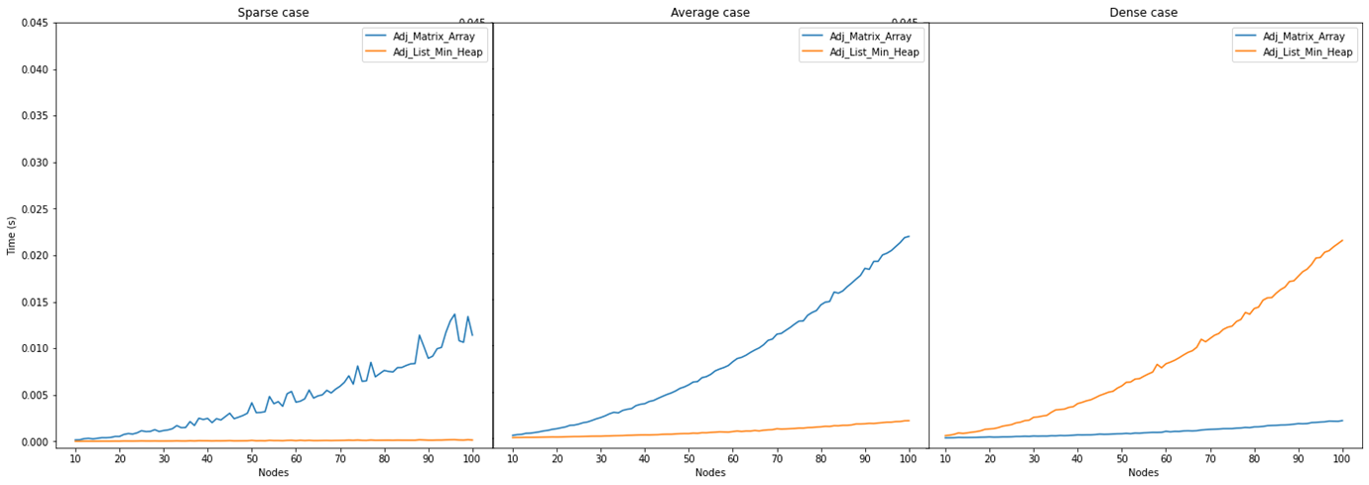
Time Complexity (Empirical Analysis)

Slide 13
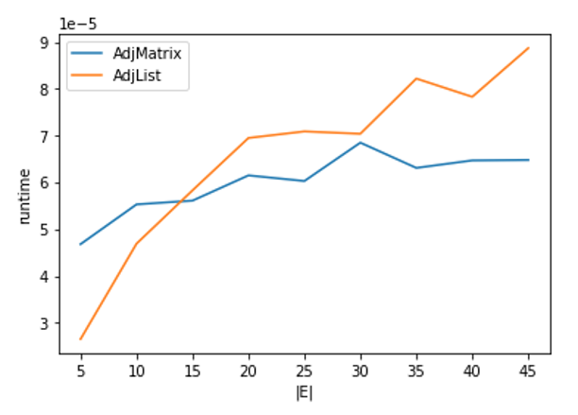
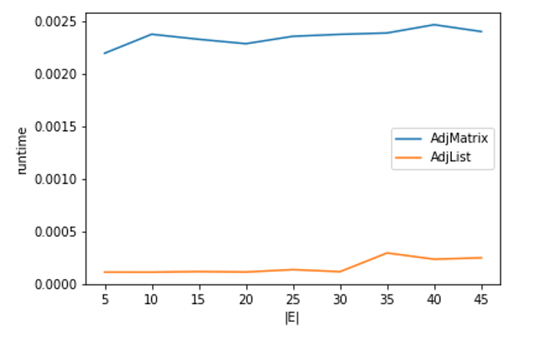
Time Complexity (Empirical Analysis)
Adjacency Matrix (Array) : O(V²)
Adjacency List (Minimising Heap): O((V+E) logV)
|V| = 10
|V| = 100

Slide 14
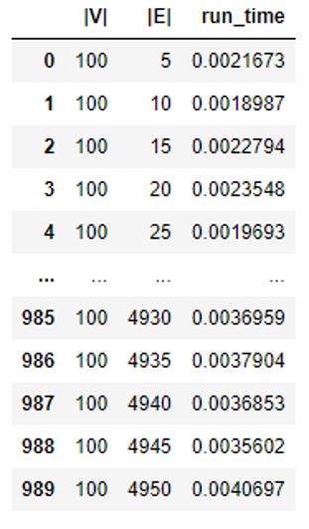
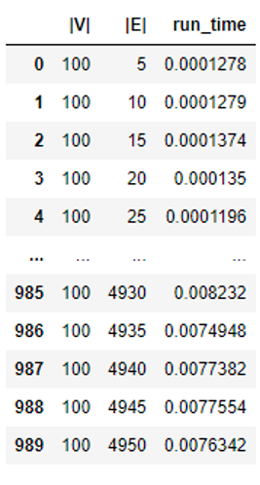
Time Complexity (Empirical Analysis)
Adjacency Matrix with Array
Adjacency List with minHeap

Slide 15
Conclusion
We observe that Priority Queue method would outperform the Minimising Heap one when the graph is dense, but not when it is sparse.
Therefore, using a minimising heap would still be more efficient than an array given the average case scenario.

